Slide 1
Programming III
Centennial College
2020 Winter
Topic: Entity Framework

Slide 2
Objectives
Upon completion of this work, the learner will be able to use entity framework to create a new database as well as consume the existing database

Slide 3
What is Entity Framework
Entity Framework (EF) is an object-relational mapper that enables .NET developers to work with relational data using domain-specific objects. It eliminates the need for most of the data-access code that developers usually need to write.

Slide 4
History of Entity Framework(1/4)
Entity Framework 1
Was provider-based and offered access to several relational database
The model types have to be derived from EntityObject class
Entity Framework 4
Support two models, Database First and Model First

Slide 5
History of Entity Framework(2/4)
Entity Framework 5
Is used in Visual Studio 2010 and Visual Studio 2012 to write applications that target .NET 4.0 and .NET 4.5
If you create a new model using the Entity Framework Designer in Visual Studio 2015, the EF5 NuGet package will be installed to your project and the generated code will make use of EF5.

Slide 6
History of Entity Framework(3/4)
Entity Framework 6
Can be used in Visual Studio 2013, Visual Studio 2012 and Visual Studio 2010 (runtime only) to write applications that target .NET 4.0 and .NET 4.5
The complete code of Entity Framework has moved to NuGet package

Slide 7
History of Entity Framework(4/4)
Entity Framework Core 1.0/2.0
Is a complete rewrite
Is based on .NET core, thus can be used on Linux and Mac system
No longer supports the XML mapping with CSDL(Conceptual Schema Definition Language), SSDL(Storage Schema Definition), and MSL(Mapping Schema Language)
Support both relational database and NoSql database
Not as stable as EF 6 (https://entityframeworkcore.com/)

Slide 8
Entity Framework 6
Microsoft Entity Framework provides three approaches
Model First
Database First
Code first
Generate database from the data model classes
Generate data model classes from an existing database

Slide 9
Database First
If the database exists, the Entity Framework designer built into Visual Studio can automatically generate a data model that consists of classes and properties that correspond to existing database objects such as tables and columns. The information about the database structure (store schema), the data model (conceptual model), and the mapping between them is stored in XML in an .edmx file. The Entity Framework designer provides a graphical UI that you can use to display and edit the .edmx file.

Slide 10
Code First
If the database does not exist, developer can code classes and properties that correspond to tables and columns. If the database exists, Entity Framework tools can generate the classes and properties that correspond to existing tables and columns. The mapping between the store schema and the conceptual model represented by the code is handled by convention and by a special mapping API.

Slide 11
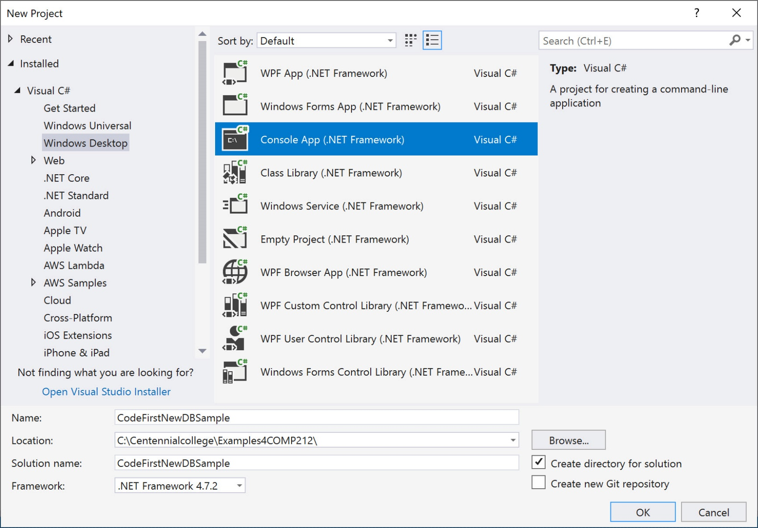
Create an Application

Slide 12
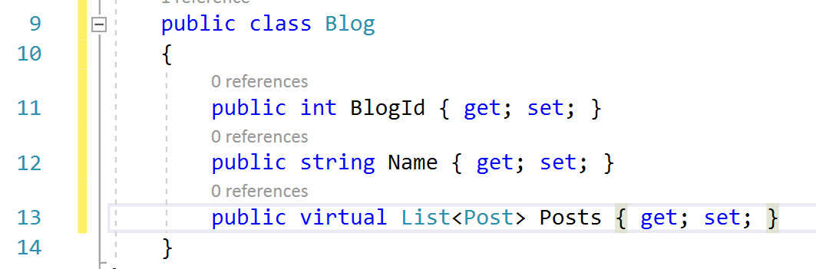
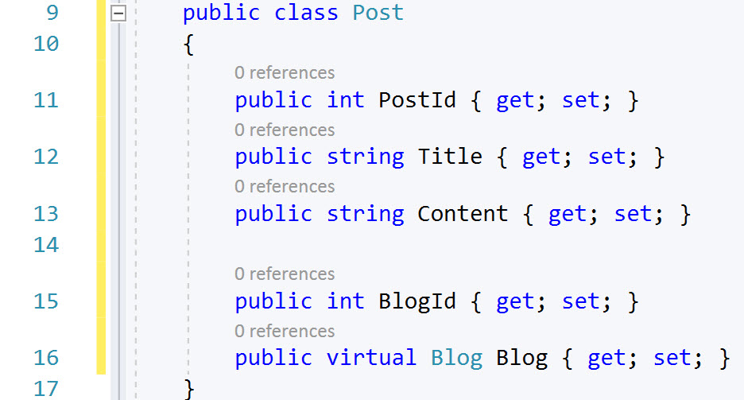
Create the Model

Slide 13
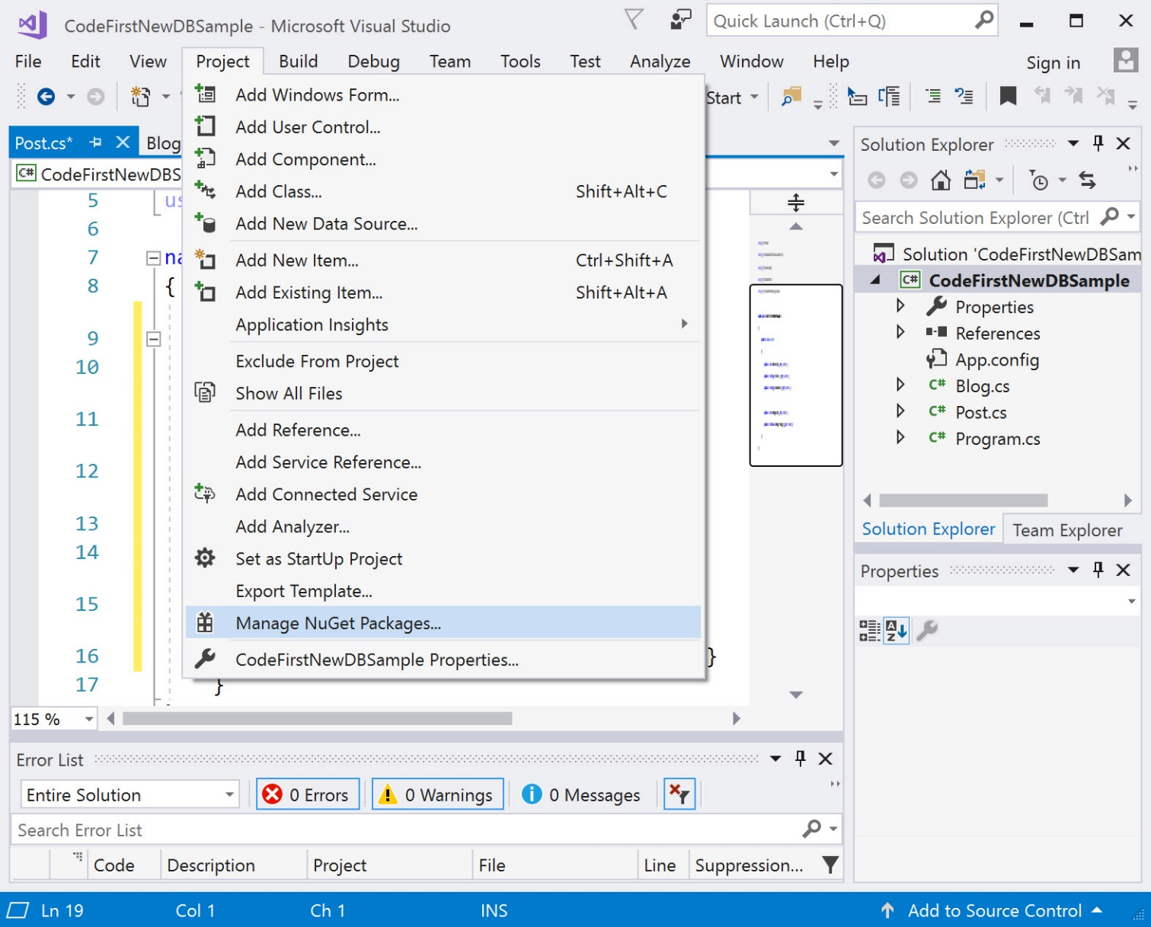
Create the Context(1/3)

Slide 14
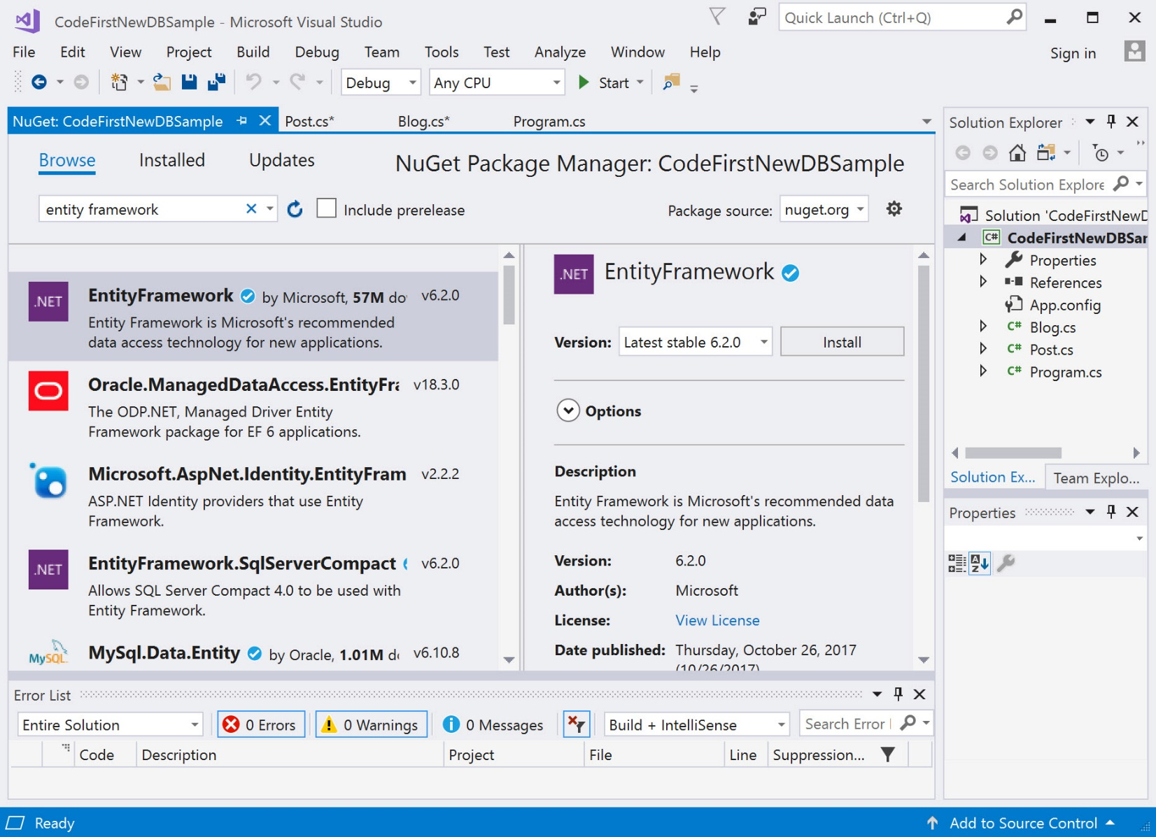
Create the Context(2/3)

Slide 15
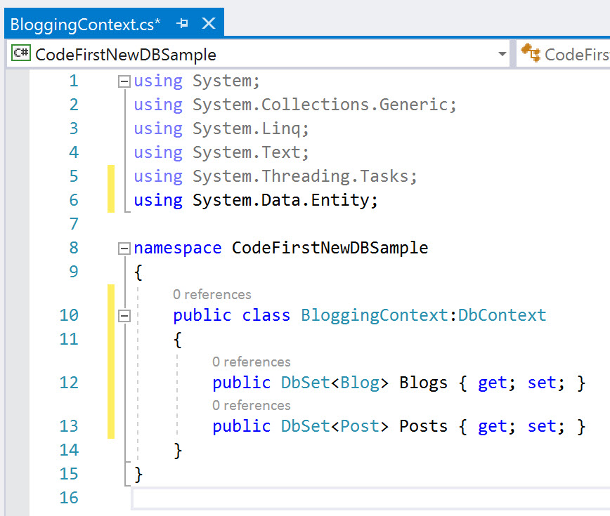
Create the Context(3/3)
A DbSet represents a typed entity set that is used to perform create, read, update and delete operation. DbSet can be only used with DbContext

Slide 16
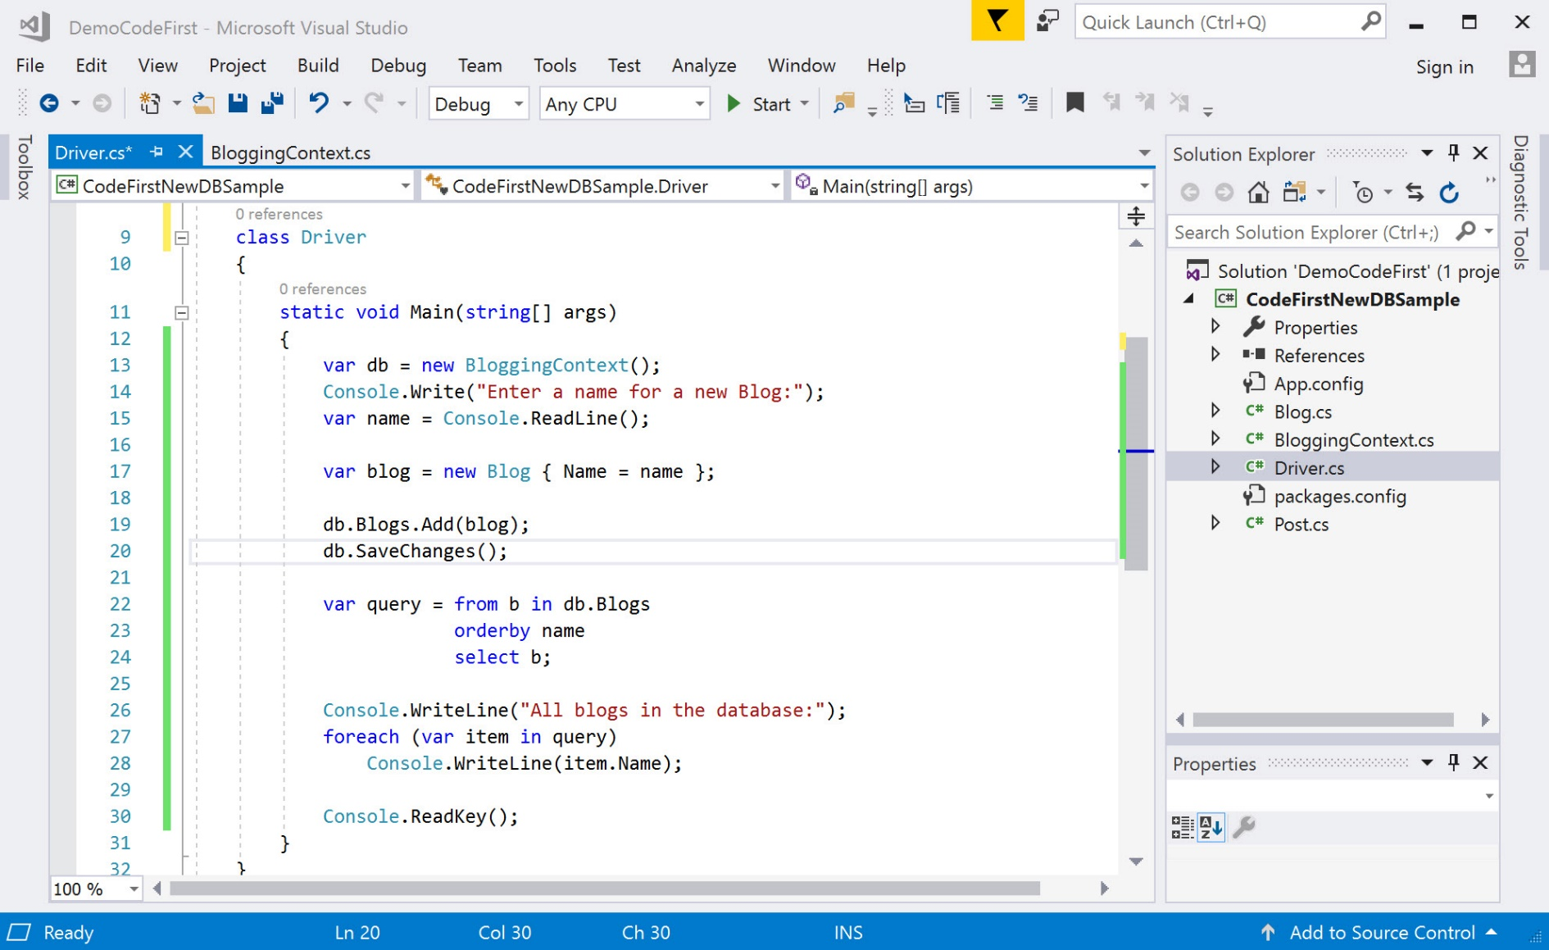
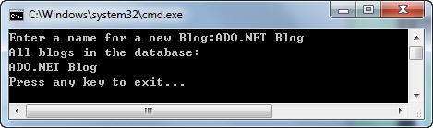
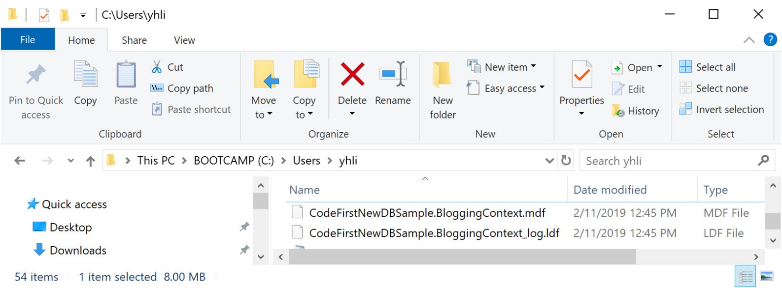
Create Database By Using C#

Slide 17
DbContext Class
Manages the data flow between the program and the database
Populate objects with data from a database
Change tracking
Persist data to the database.

Slide 18
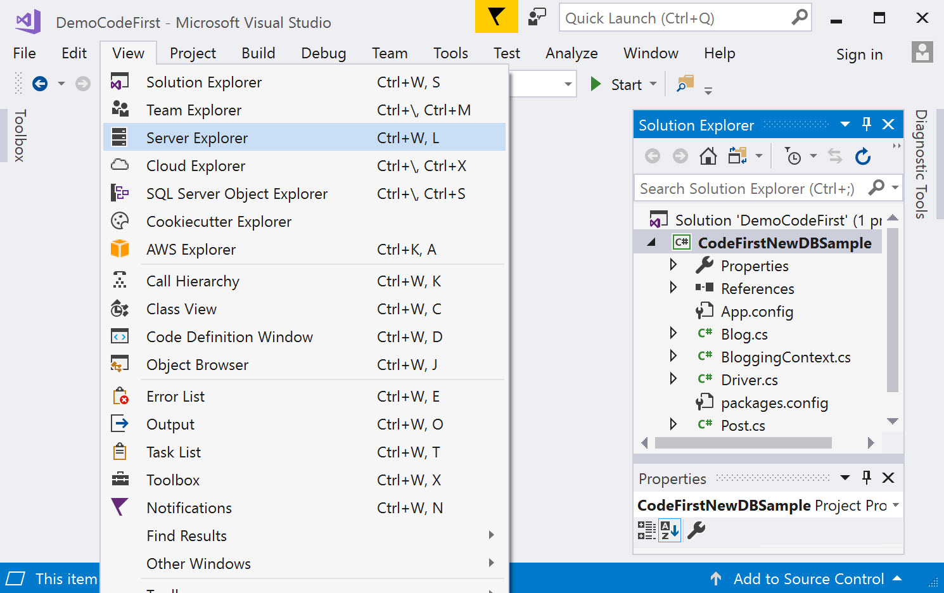
Connect to the Database Created(1/4)

Slide 19
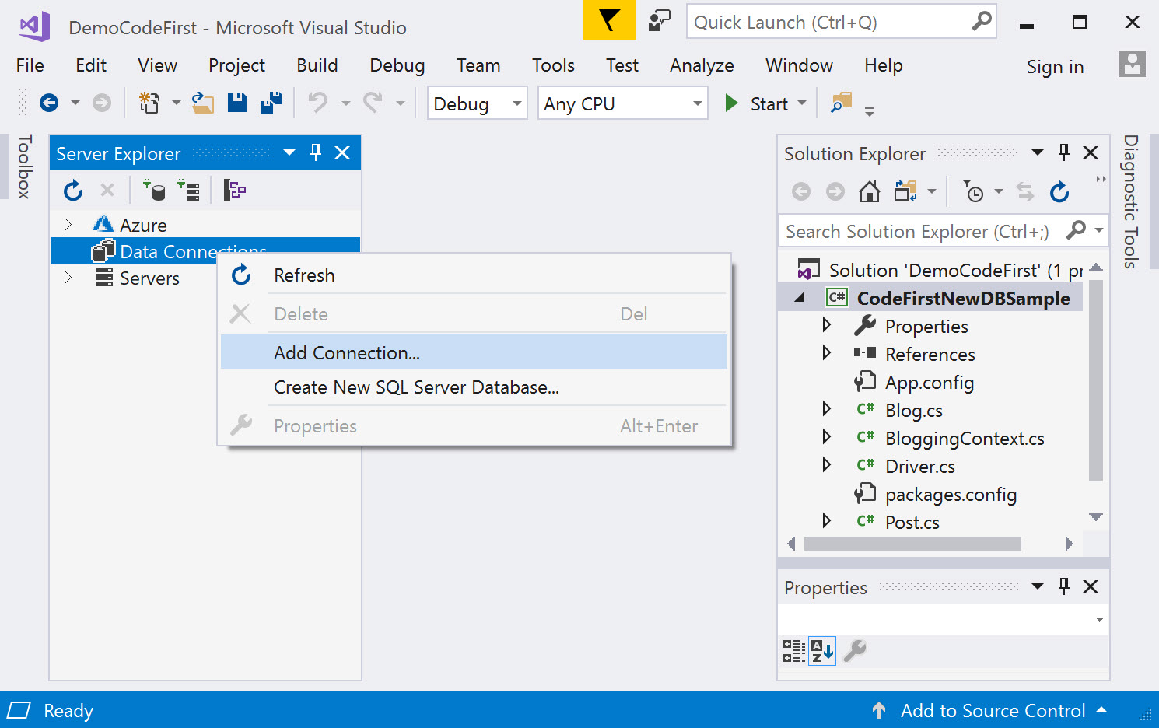
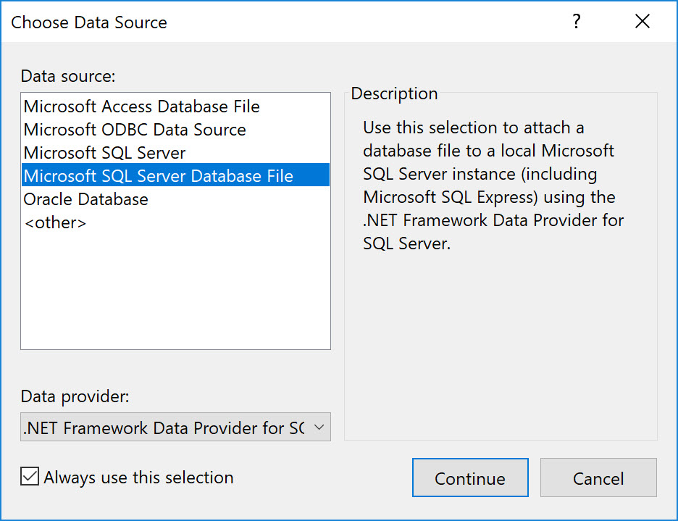
Connect to the Database Created(2/4)

Slide 20
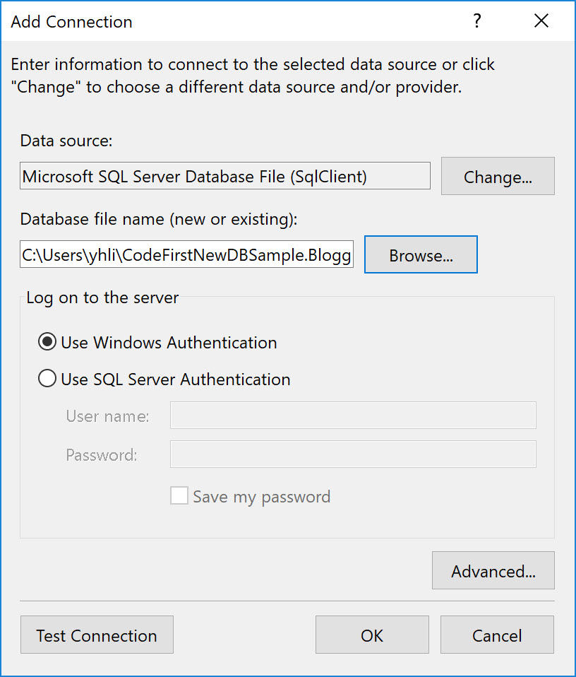
Connect to the Database Created(3/4)

Slide 21
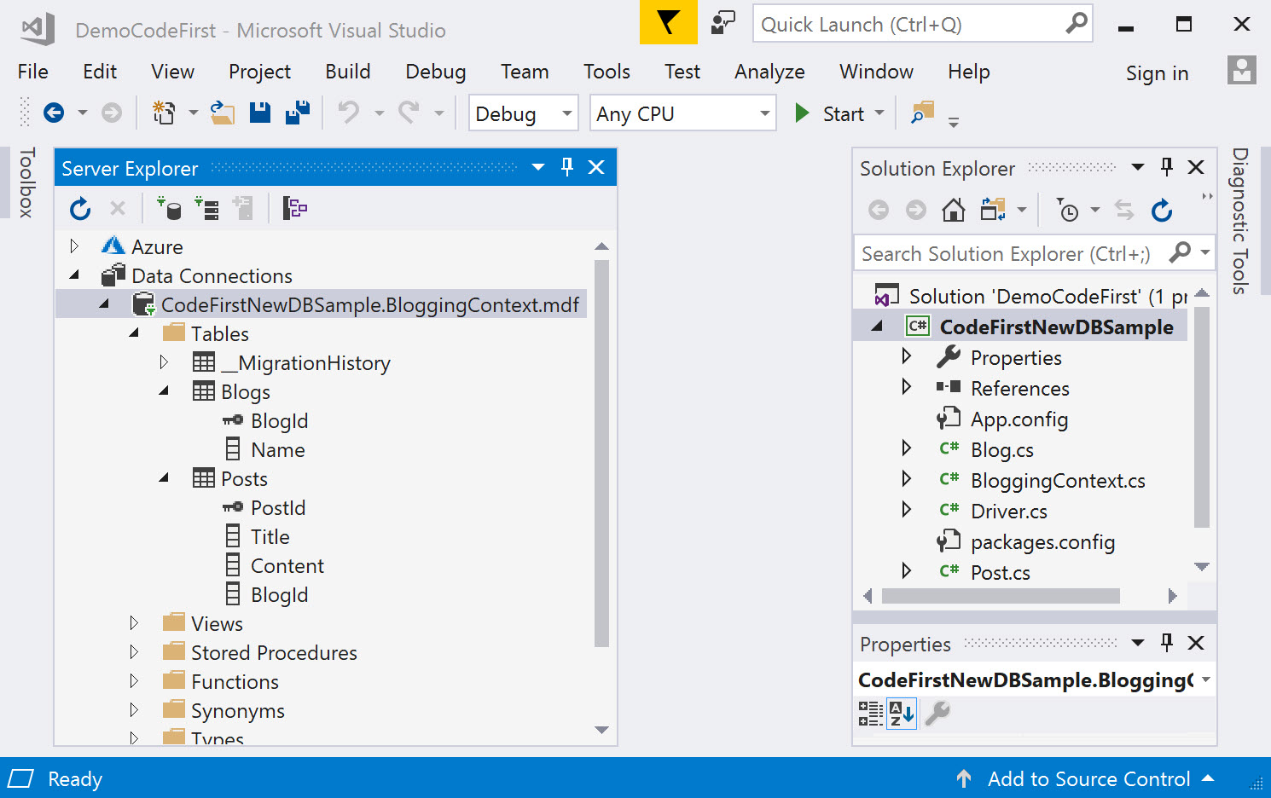
Connect to the Database Created(4/4)

Slide 22
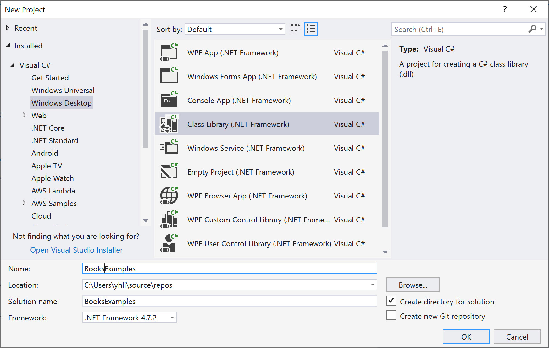
Application to Use an Existing Database

Slide 23
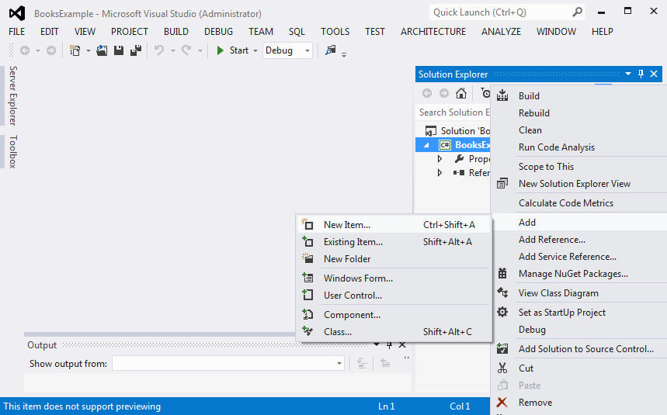
Add Entity Data Model(1/7)

Slide 24
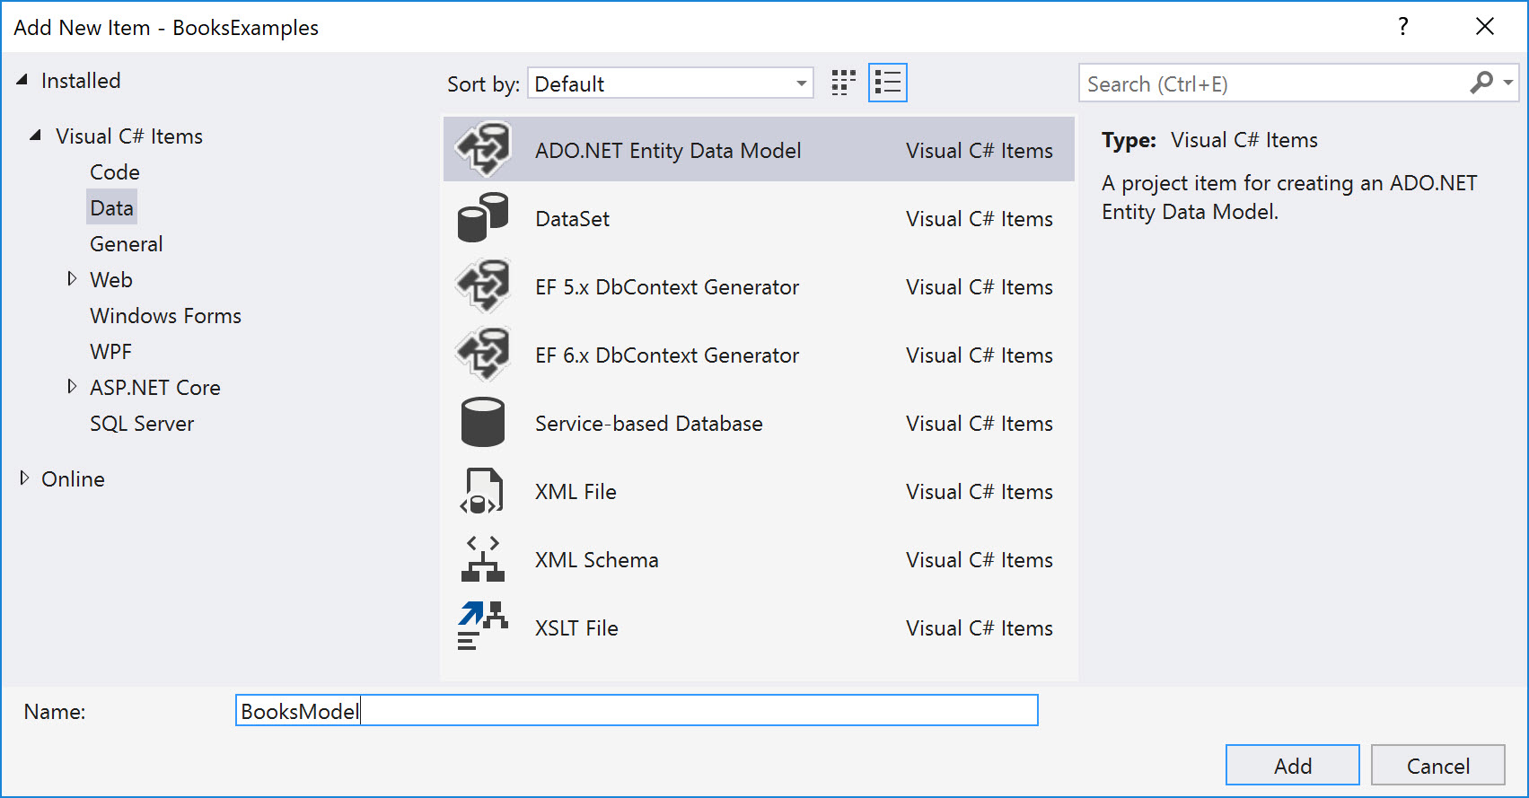
Add Entity Data Model(2/7)

Slide 25
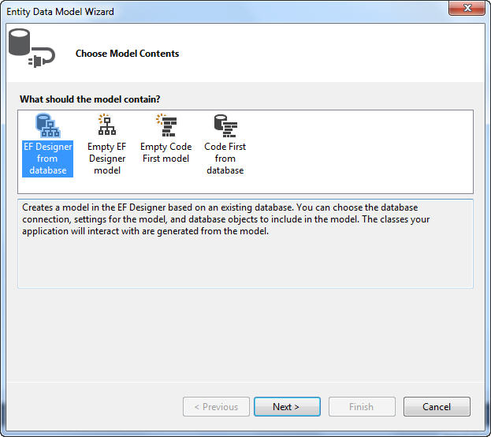
Add Entity Data Model(3/7)

Slide 26
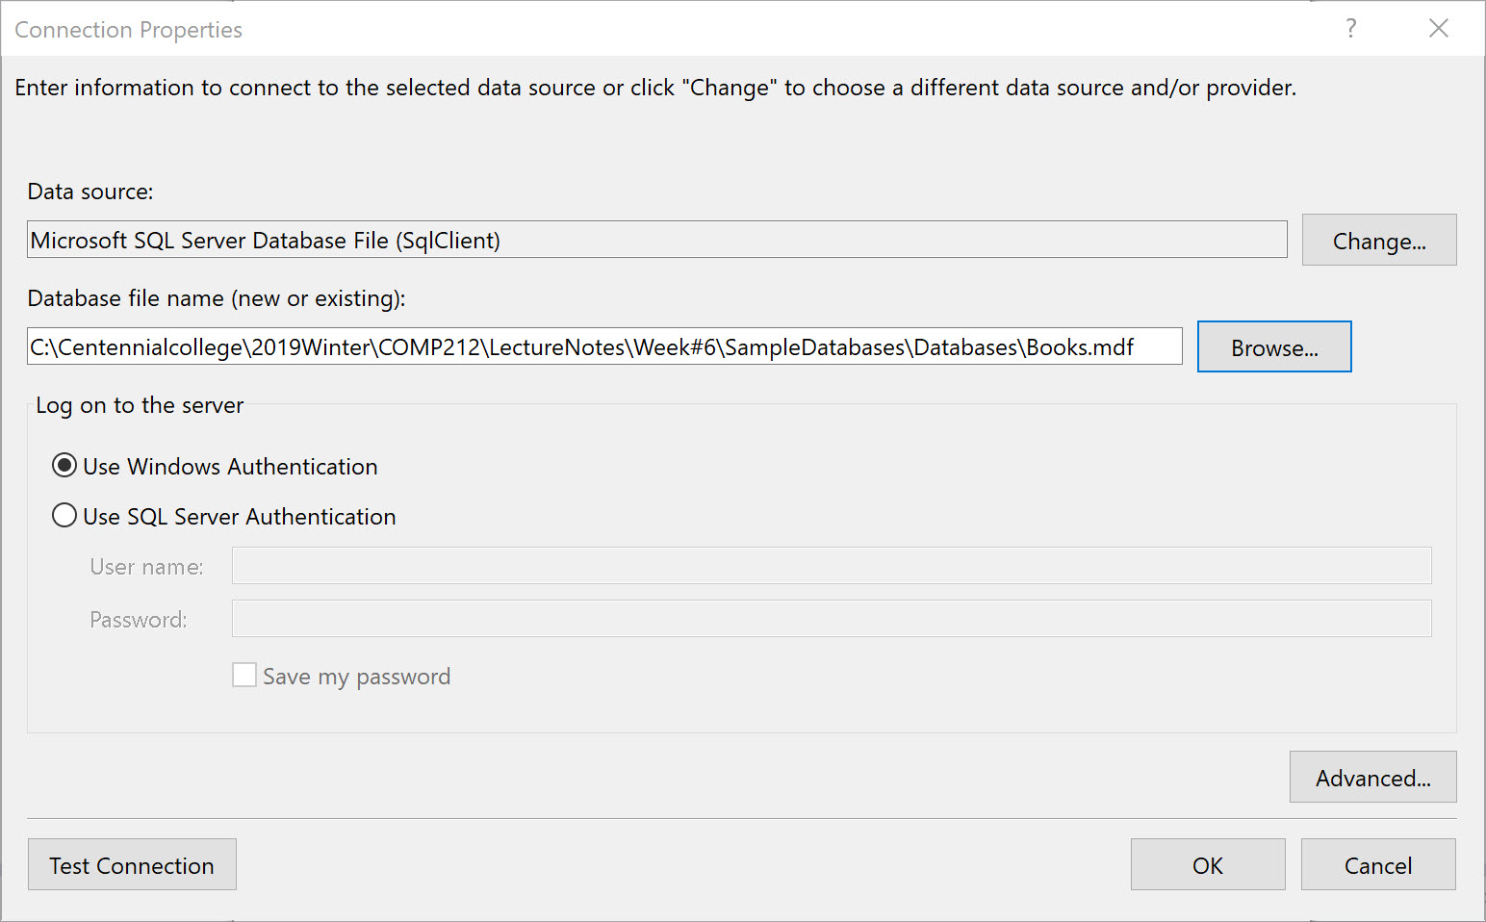
Add Entity Data Model(4/7)

Slide 27
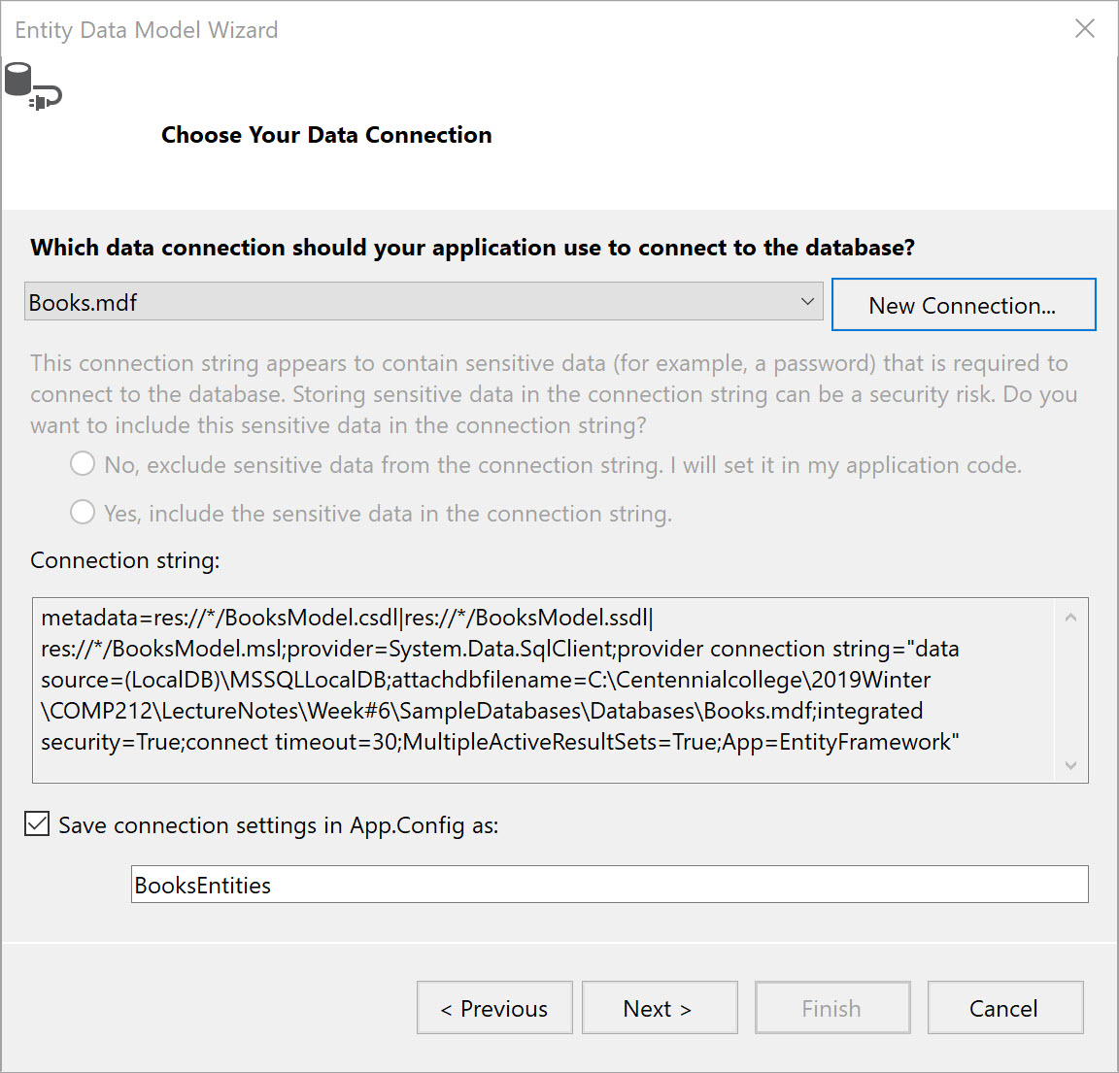
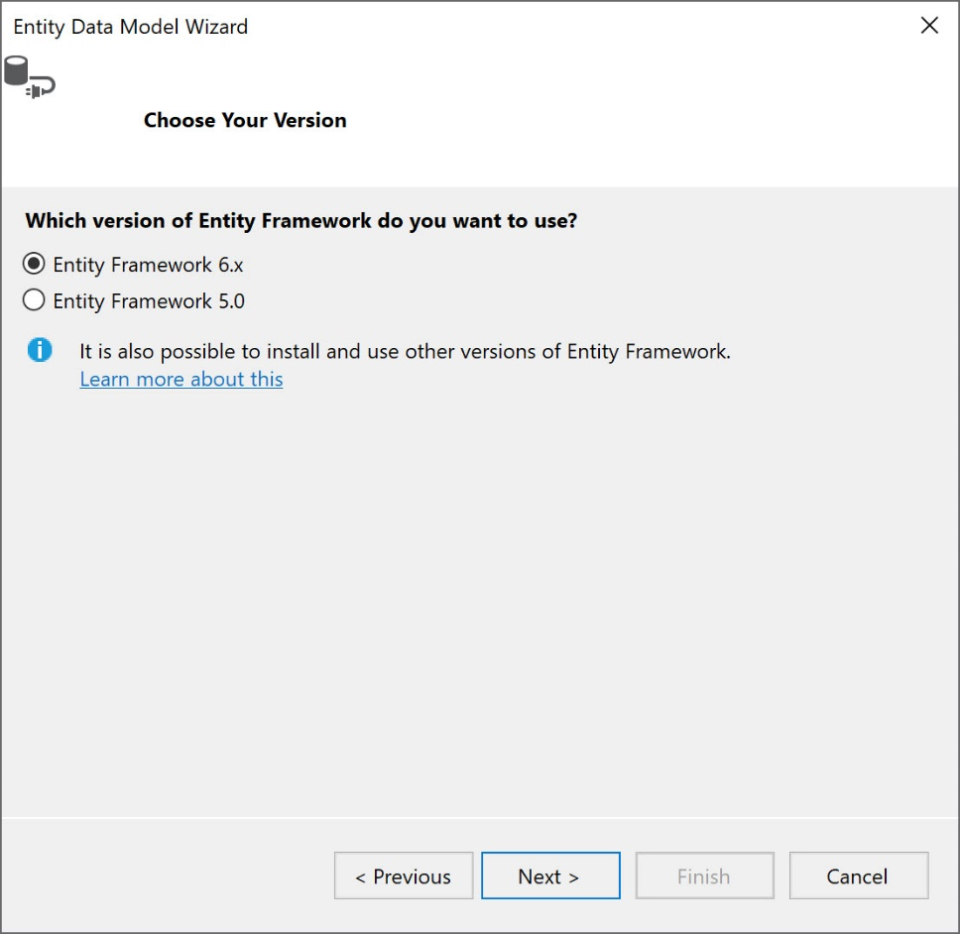
Add Entity Data Model(5/7)

Slide 28
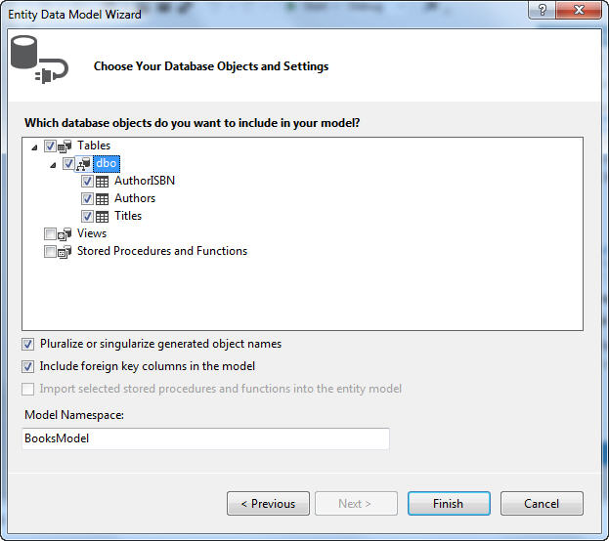
Add Entity Data Model(6/7)

Slide 29
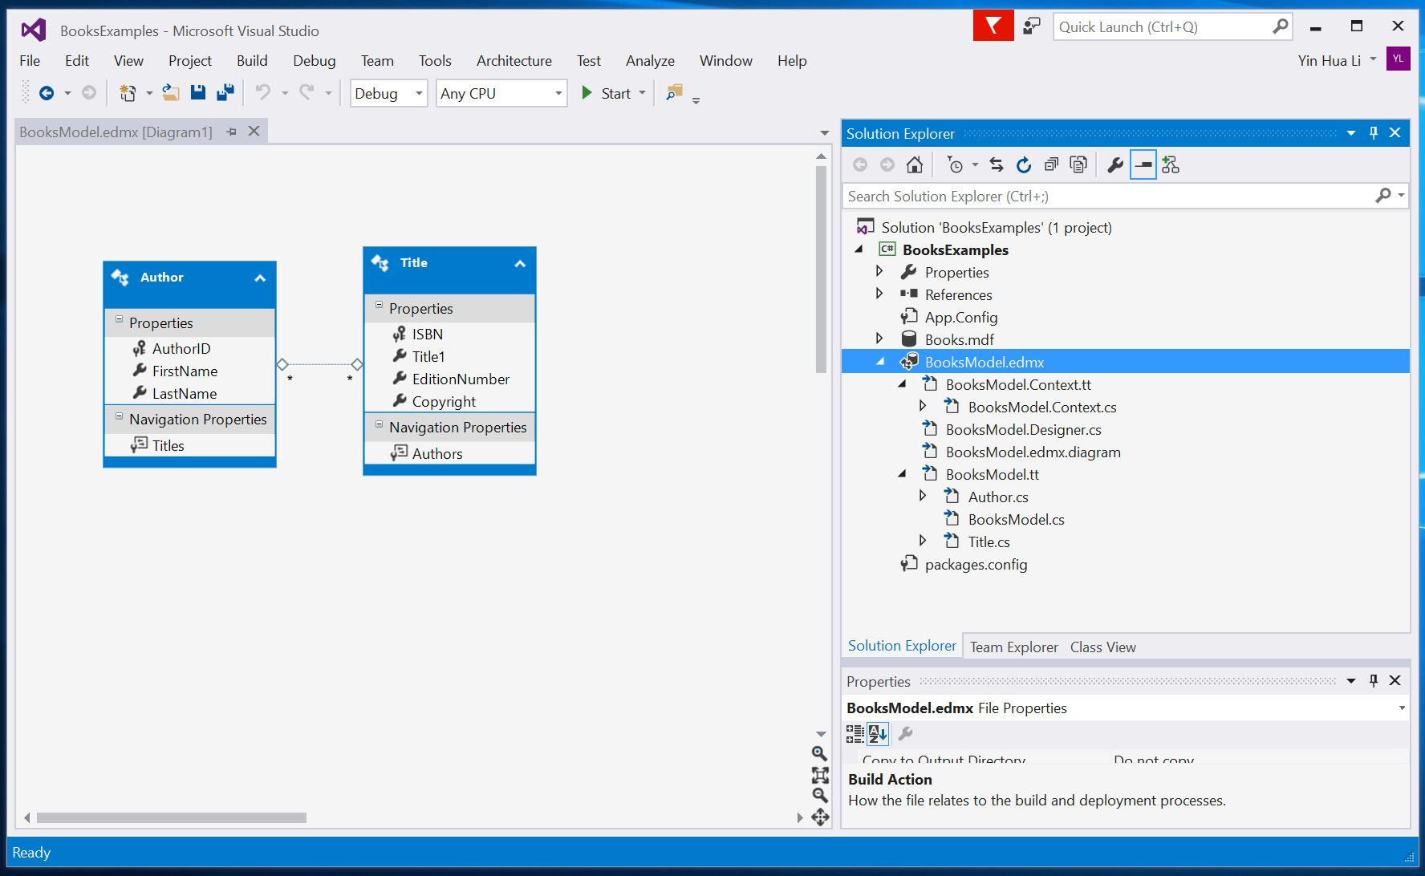
Add Entity Data Model(7/7)

Slide 30
More on the Entity Data Model Diagram
The diagram contains Author and Title entities
The line between the entities indicates a relationship between Author and Title
The Navigation Properties section in the Author property contains the Titles property which connects an author to all titles written by the author

Slide 31
More on the Entity Data Model
BooksModel.Context.tt
Contains the core context class that is extended from DbContext class
BooksModel.tt
Contains classes where the class name will be the same as the table name in the database, and property name is the same as in the related table

Slide 32
Build the Class Library
The IDE generates the classes that are used to interact with the database while building the Class Library
A class for each table selected from the database
BooksEntities, derived from DbContext, enables to programmatically interact with the database

Slide 33
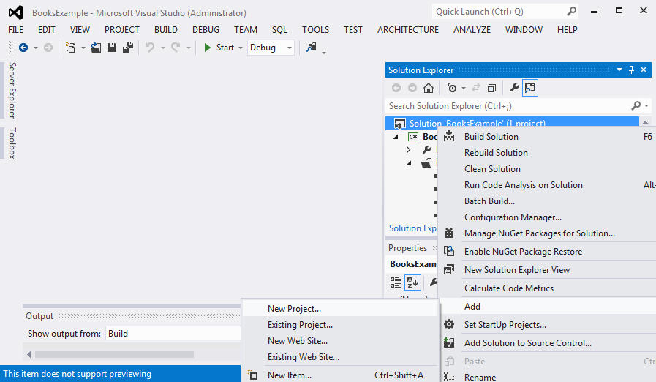
Create a Windows Form App to Use the Entity Data Model

Slide 34
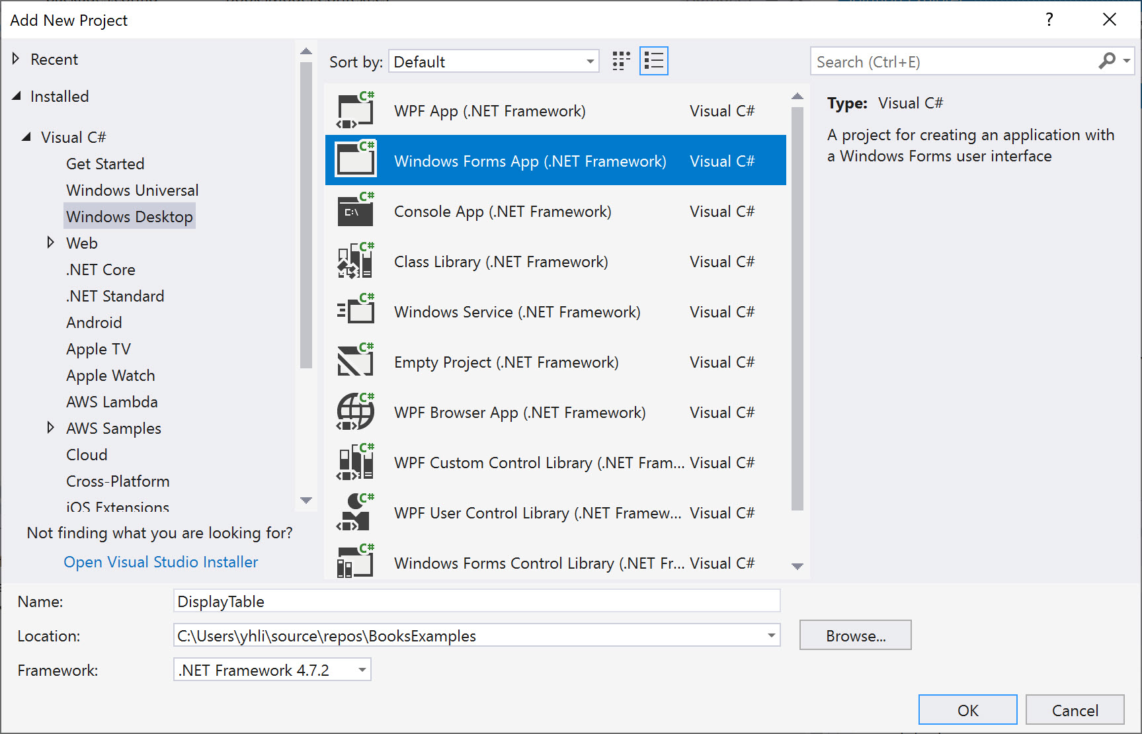
Create a Windows From Project

Slide 35
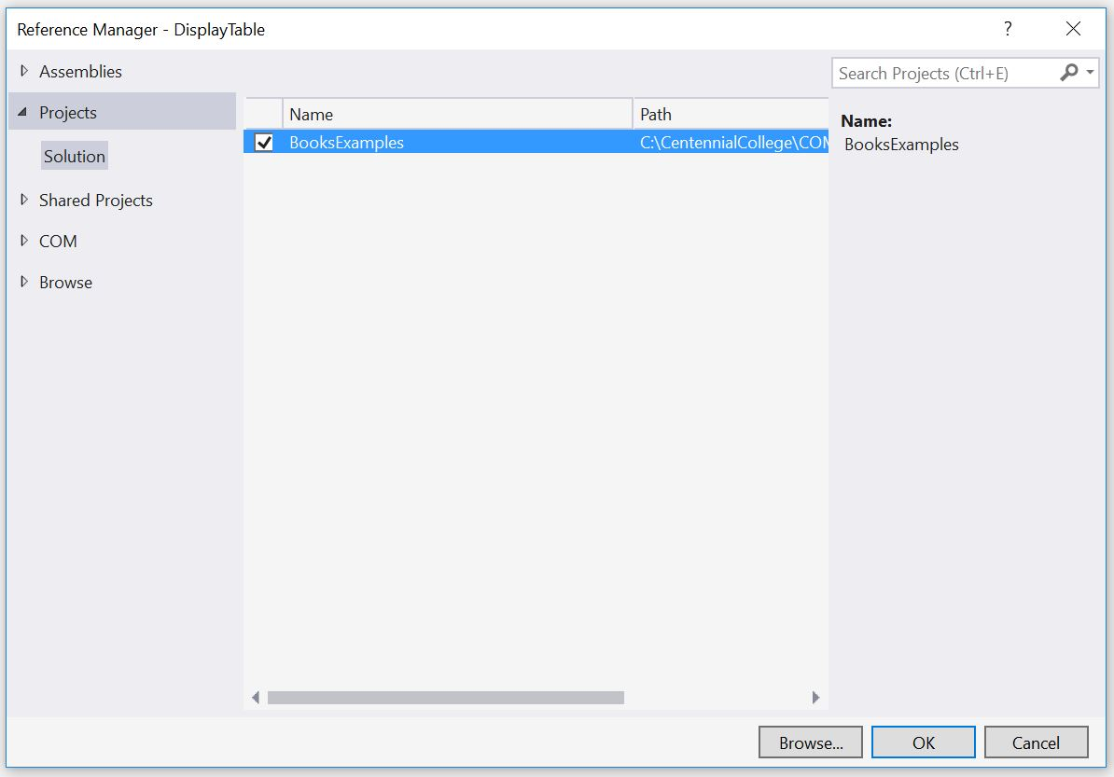
Add a Reference to the Class Library

Slide 36
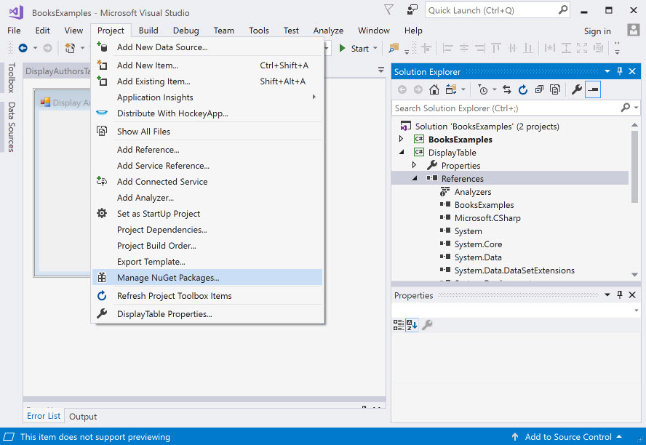
Add Reference to EntityFramework

Slide 37
Add the Connection String to Windows Form App
From App.Config of BooksExample class library project, copy <connectionStrings> element and paste it to App.Config of DisplayTable project

Slide 38
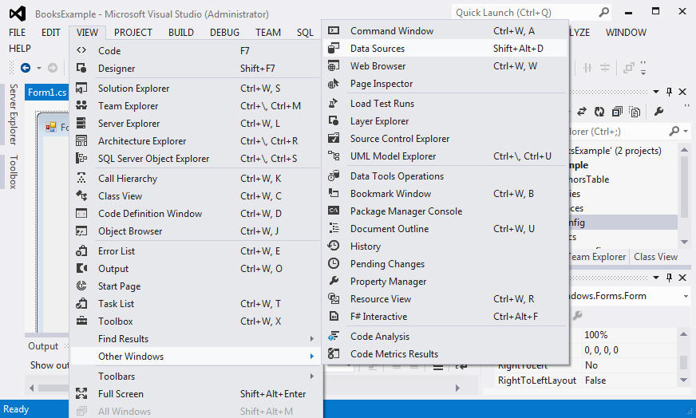
Data Binding Between Controls & the Entity Data Model

Slide 39
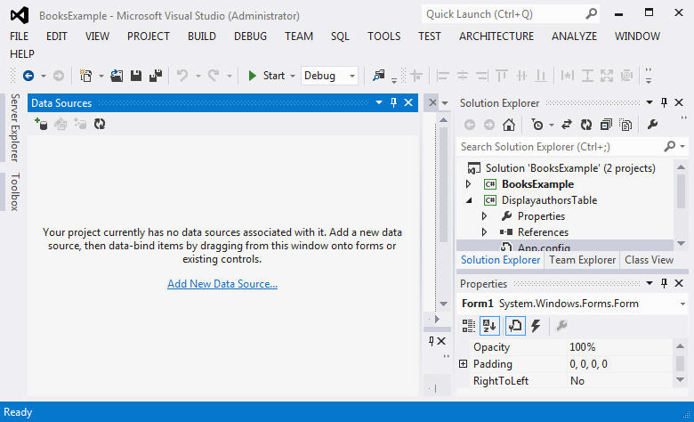
Add Data Source(1/6)

Slide 40
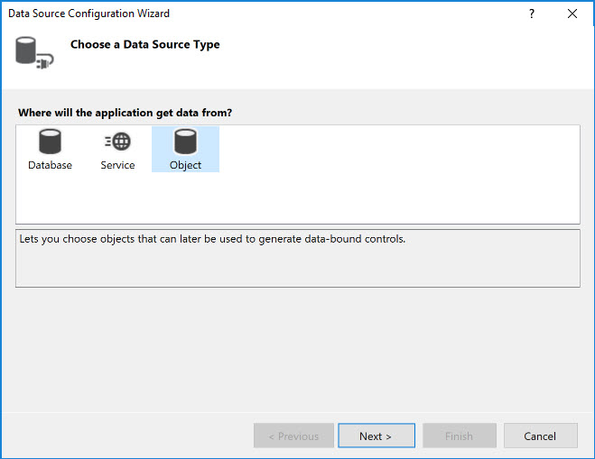
Add Data Source(2/6)

Slide 41
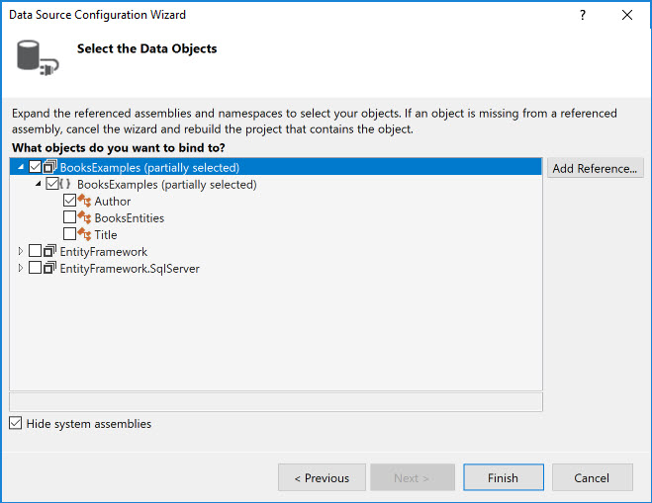
Add Data Source(3/6)

Slide 42
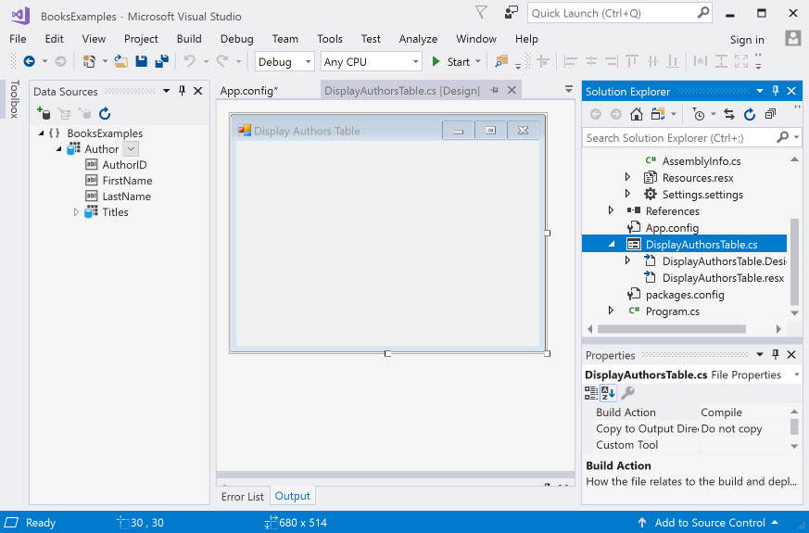
Add Data Source(4/6)

Slide 43
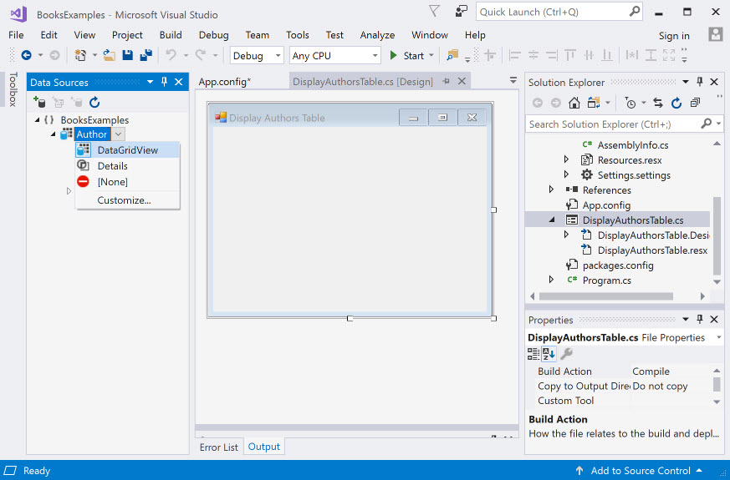
Add Data Source(5/6)

Slide 44
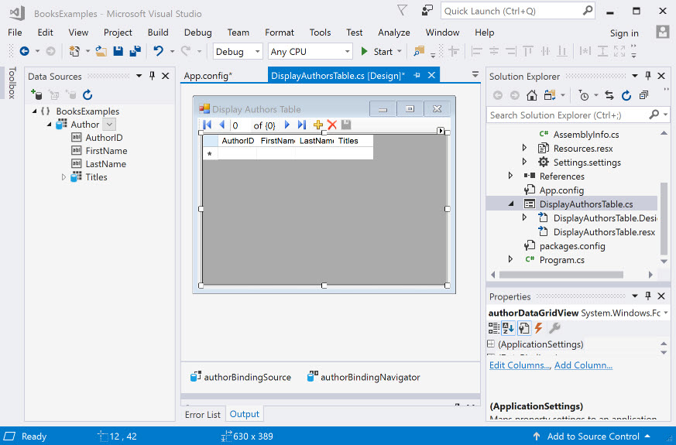
Add Data Source(6/6)
Drag the Author node from Data Source window to the form

Slide 45
More on DataGridView
BindingNavigator contains buttons for moving between entries, adding entries, deleting entries and saving changes to the database
BindingResource: handles the transfer of data between the data source and the data-bound controls on the Form

Slide 46
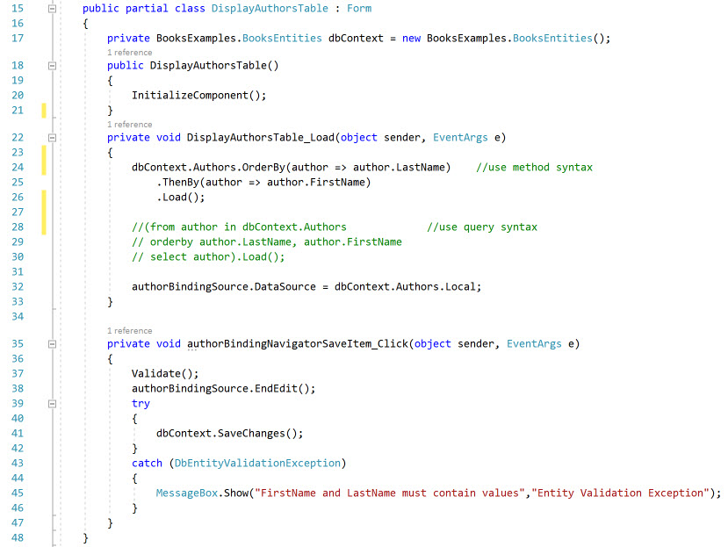
Connect Data Source to the authorBindingSource

Slide 47
Reference
https://msdn.microsoft.com/en-us/data/jj193542
https://msdn.microsoft.com/en-us/library/ms178359.aspx#dbfmfcf
https://www.c-sharpcorner.com/article/code-first-approach-and-migrations-in-microsoft-net-entity-framework/

